Slide 1
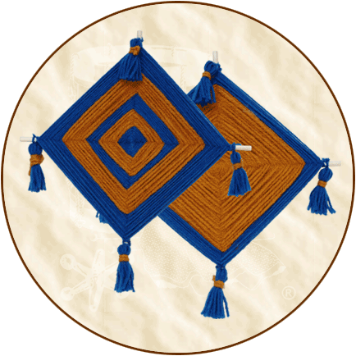
God’s Eye Ojo de Dios

Slide 2
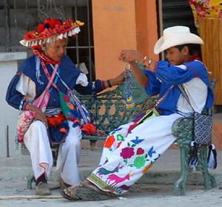
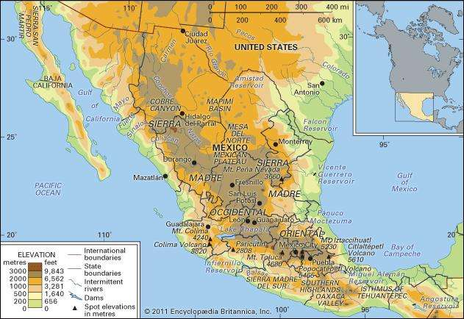
Unique Weaving
Early Spaniards came to Mexico and encountered the Huichol (wet-chol) people
They lived in the Sierra Madre Mountains of Mexico

Slide 3
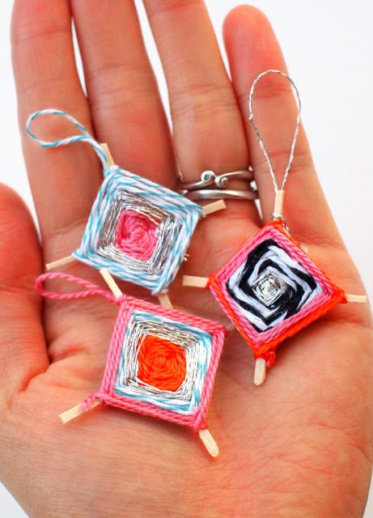
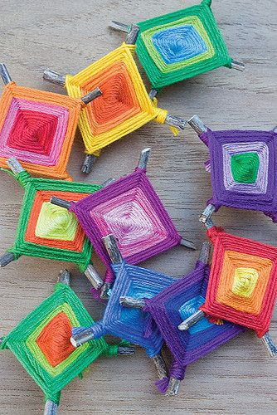
What is an Ojo de Dios?
The Huichol Indigenous people made these “God’s eyes” as a form of protection to watch over their loved ones.
The weaving is a symbol of the power of seeing and understanding things that cannot be seen.
Some say the four points represent earth, air, water and fire
To make a an “Ojo de Dios” all you need is some sticks and yarn and your hands!
Check out this tutorial
https://youtu.be/X53ZXcHoR_c

